Slide 1

Classical predictive models: regression approach
Bartosz Witkowski, PhD
Full Professor – SGH Warsaw School of Economics
bwitko@sgh.waw.pl
Preparation of this workshop has been supported by the Polish National Agency for Academic Exchange under the Strategic Partnerships programme, grant number BPI/PST/2021/1/00069/U/00001.

Slide 2
Classic econometrics vs machine learning
Why do we do econometrics?
→ Forecasting
→ Identifying relations
So… which type of tools is better?
As usual: there is no single answer

Slide 3
Machine learning: pros and cons
Idea: provide efficient forecasts of whatever you are interested in
Works like a black box: does not identify causality, relations, concentrated and efficient in identifying patterns
Requires big sets of data
+ Accurate in forecasting of what is going to happen
- Does not identify why something happens; requires a lot of data, not robust to unstable relations

Slide 4
Classic econometrics: pros and cons
Idea: identify the data generating proces (DGP), possibly use it for forecasting
Uses functional relations between variables of interest; researcher decides what function to use
Requires fewer observations than machine learning
+ Allows to identify why something happens and which determinants play what role, thus may be ammended if non-stability is present
- Usually not as accurate in forecasting as the big-data tools, requires knowledge (or deeper analysis) of the undelying processes

Slide 5
Regression
General steps:
identify what you want to explain with your model
identify the underyling DGP (well, almost always…)
write the function relating the dependent and independent variables
use a sample of data to identify the values of parameteres of your function and treat them as estimates of population parameters
The most annoying part: error term and the numerous assumptions that we make

Slide 6


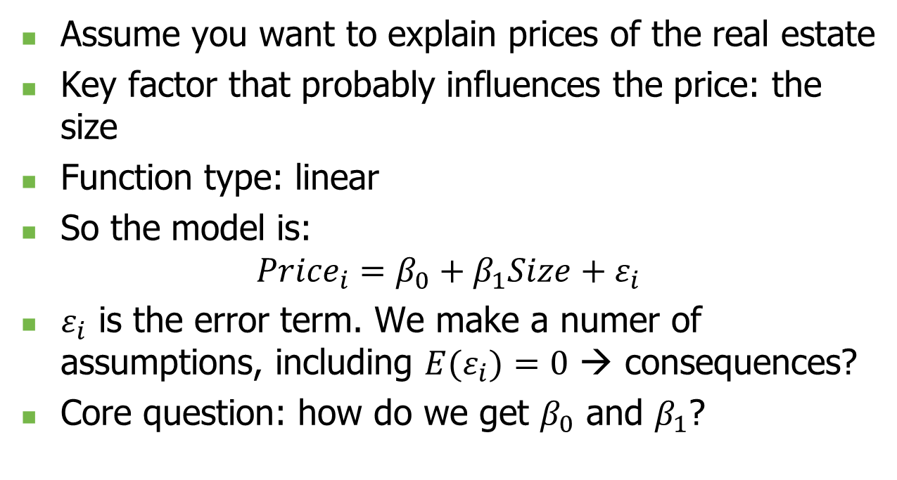
Easiest example ever
Assume you want to explain prices of the real estate
Key factor that probably influences the price: the size
Function type: linear
So the model is:
$${Price}_{i}=β_{0}+β_{1}Size+ε_{i}$$
$ε_{i}$ is the error term. We make a numer of assumptions, including ${E(ε}_{i})=0$ → consequences?
Core question: how do we get $β_{0}$ and $β_{1}$?

Slide 7
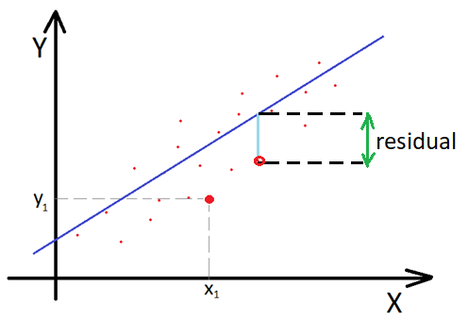
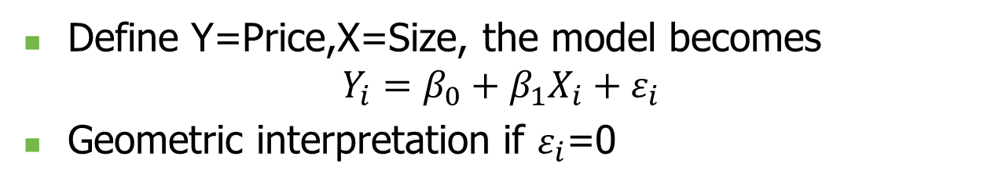
Geometric interpretation
Define Y=Price,X=Size, the model becomes
$$Y_{i}=β_{0}+β_{1}X_{i}+ε_{i}$$
Geometric interpretation if $ε_{i}$=0
By the way: how many observations would suffice to do the job?

Slide 8
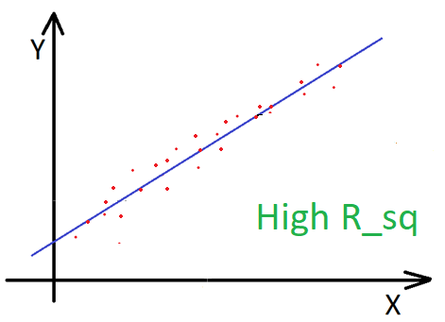
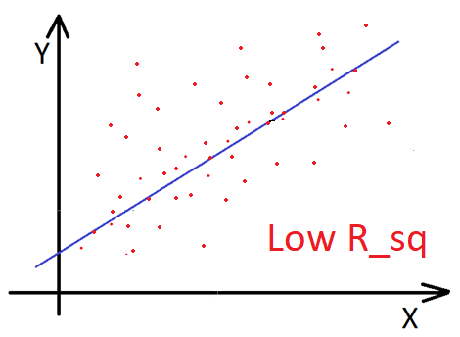
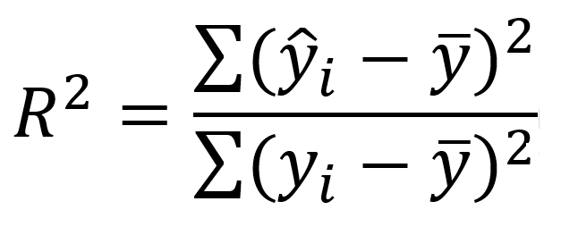
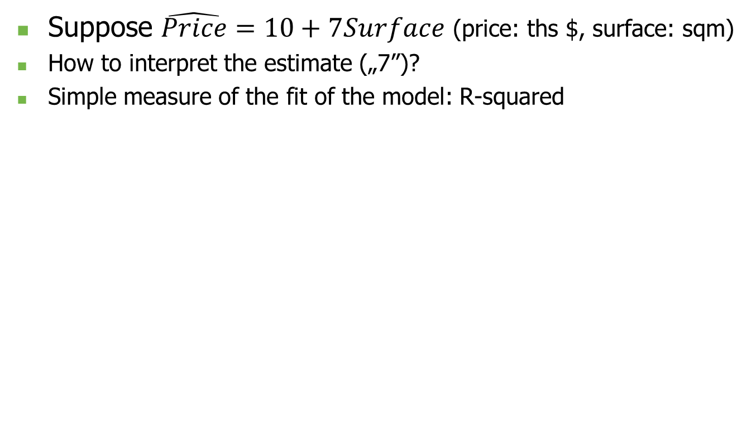
Basic interpretation
Suppose $\hat{Price}=10+7Surface$ (price: ths $, surface: sqm)
How to interpret the estimate („7”)?
Simple measure of the fit of the model: R-squared

Slide 9
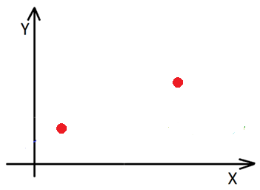
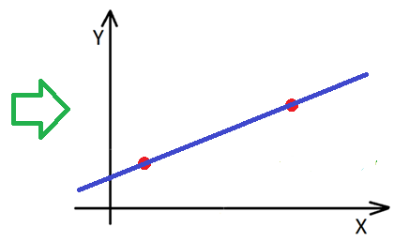
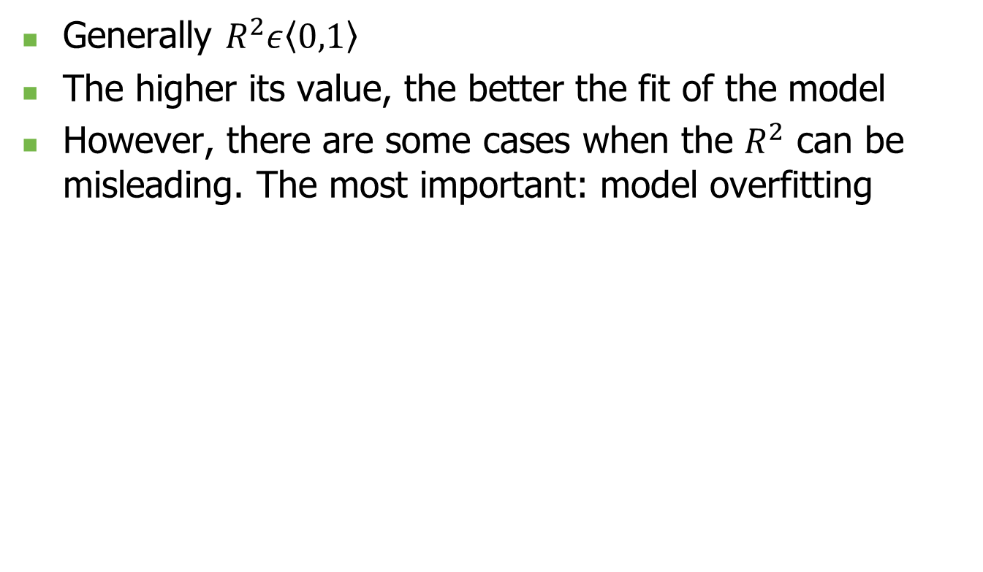
R squared issues
Yes, there are exceptions, for example if there is no constant, but those are not notorious
Generally $R^{2}ε\left\langle 0,1\right\rangle$
The higher its value, the better the fit of the model
However, there are some cases when the $R^{2}$ can be misleading. The most important: model overfitting

Slide 10

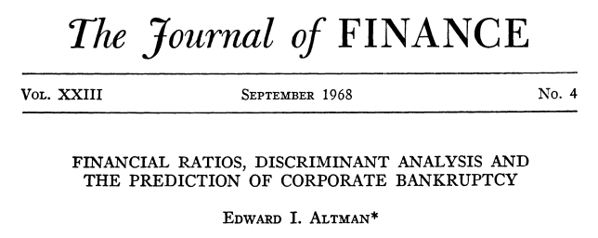
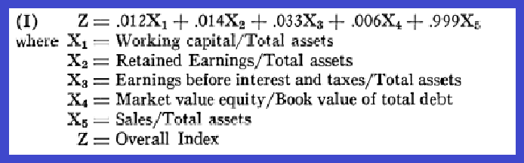
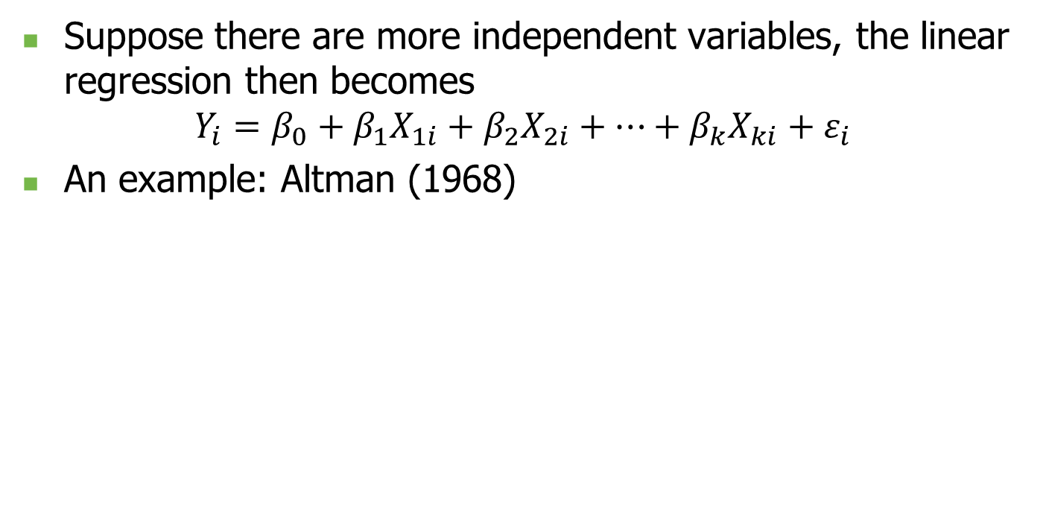
Multiple regression
Suppose there are more independent variables, the linear regression then becomes
$$Y_{i}=β_{0}+β_{1}X_{1i}+β_{2}X_{2i}+…+β_{k}X_{ki}+ε_{i}$$
An example: Altman (1968)

Slide 11
Ordinary least squares
How can we attain the values of parameters?
The difference between calculation and estimation
Most popular method of estimation of linear models: ordinary least squares (OLS)
Idea: find such estimates of parameters that minimize the sum of squared residuals
There is a bunch of assumptions that we make:
X are not correlated with the error term
X are not co-linear
Expected value of the errors equals zero
Variance of errors is constant for all the observations and the errors are not correlated with one another

Slide 12

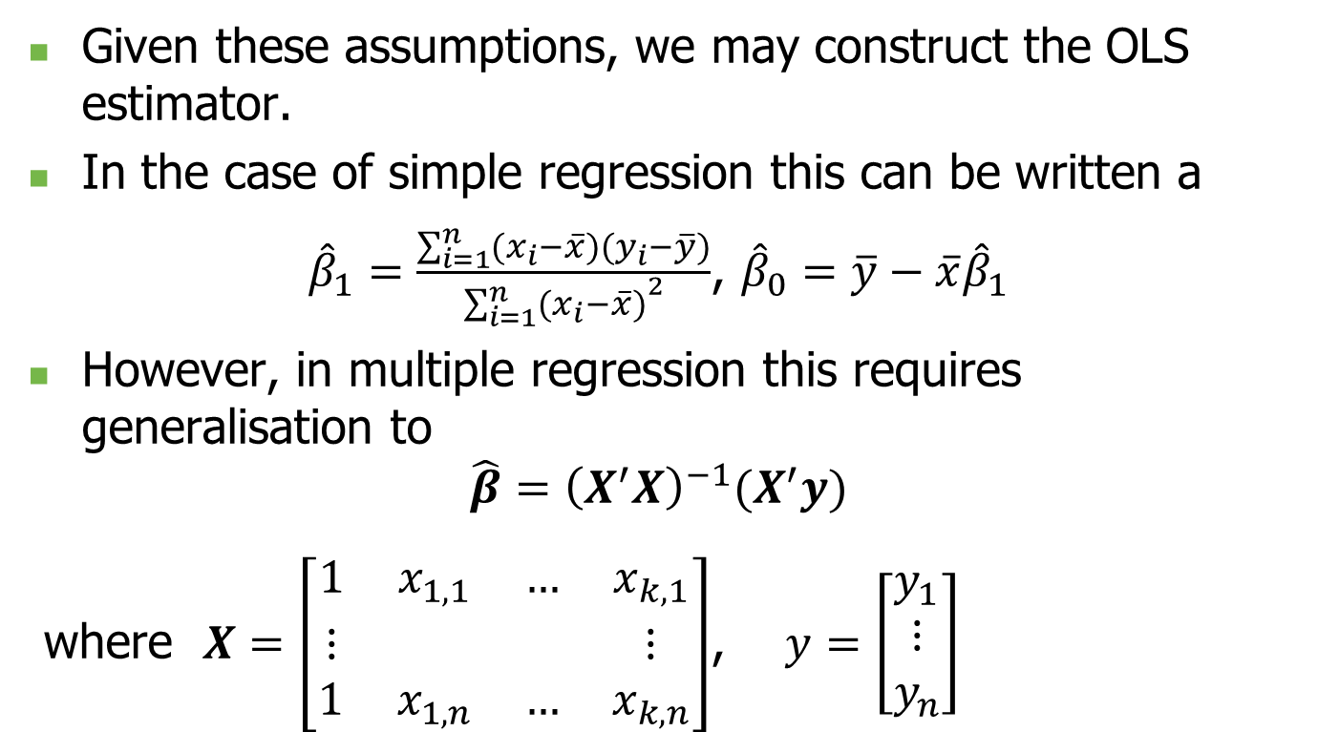
Ordinary least squares
Given these assumptions, we may construct the OLS estimator.
In the case of simple regression this can be written a
${\hat{β}}_{1}=\frac{\sum_{i=1}^{n}{(x_{i}−\overline{x})(y_{i}−\overline{y})}}{{\sum_{i=1}^{n}{(x_{i}−\overline{x})}}^{2}}$, ${\hat{β}}_{0}=\overline{y}−\overline{x}{\hat{β}}_{1}$
However, in multiple regression this requires generalisation to
$$\hat{β}={\left(X^{′}X\right)}^{−1}(X^{′}y)$$
where $X=\left[\begin{matrix}1 x_{1,1} & … & x_{k,1} \\ ⋮ & & ⋮ \\ 1 { x}_{1,n} & … & x_{k,n}\end{matrix}\right]$, $y=\left[\begin{matrix}y_{1} \\ ⋮ \\ y_{n}\end{matrix}\right]$

Slide 13
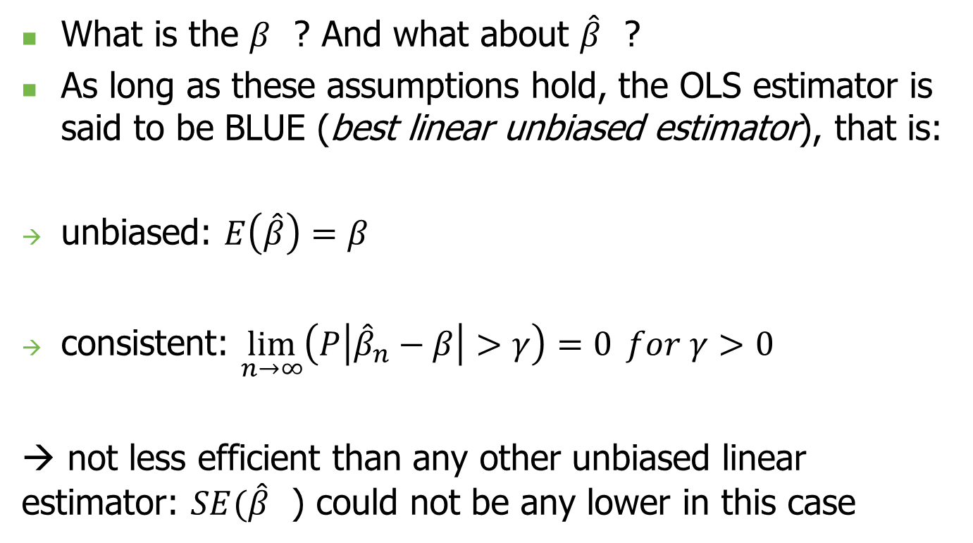
Gauss and Markov theorem
What is the $β_{}$? And what about ${\hat{β}}_{}$?
As long as these assumptions hold, the OLS estimator is said to be BLUE (best linear unbiased estimator), that is:
unbiased: $E\left(\hat{β}\right)=β$
consistent: $\lim_{n→∞}\left(P\left|{\hat{β}}_{n}−β\right|>γ\right)=0 for γ>0$
→ not less efficient than any other unbiased linear estimator: $SE({\hat{β}}_{}$) could not be any lower in this case

Slide 14
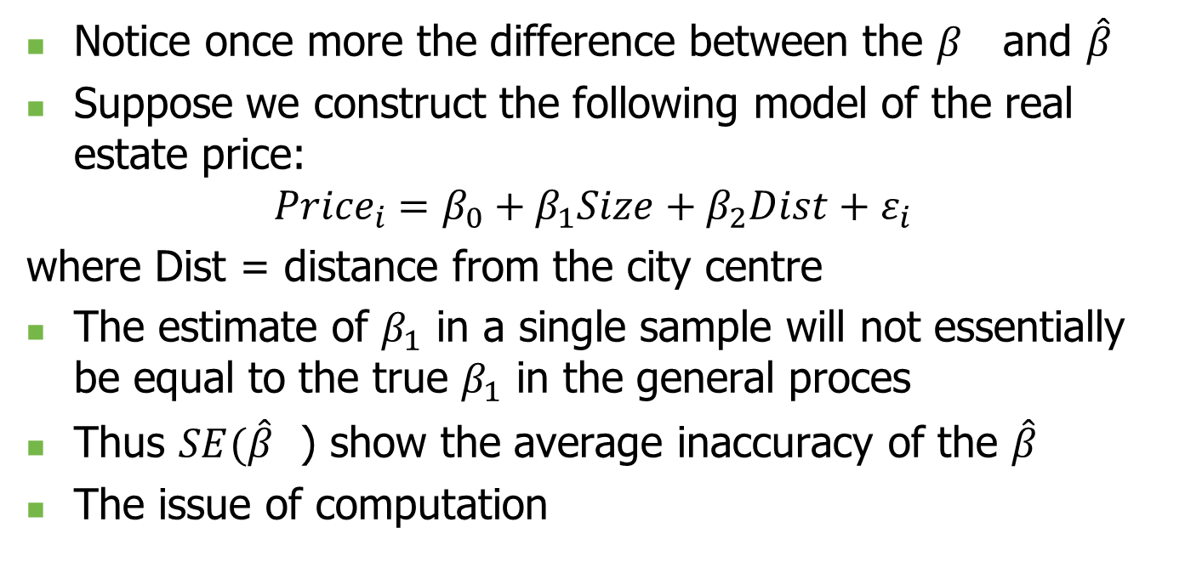
Standard errors
Notice once more the difference between the $β_{}$ and ${\hat{β}}_{}$
Suppose we construct the following model of the real estate price:
$${Price}_{i}=β_{0}+β_{1}Size+β_{2}Dist+ε_{i}$$
where Dist = distance from the city centre
The estimate of $β_{1}$ in a single sample will not essentially be equal to the true $β_{1}$ in the general proces
Thus $SE({\hat{β}}_{}$) show the average inaccuracy of the $\hat{β}$
The issue of computation
Notice: if the last of the OLS assumptions is violated (errors correlated or having different variance, so called robust SE are used

Slide 15
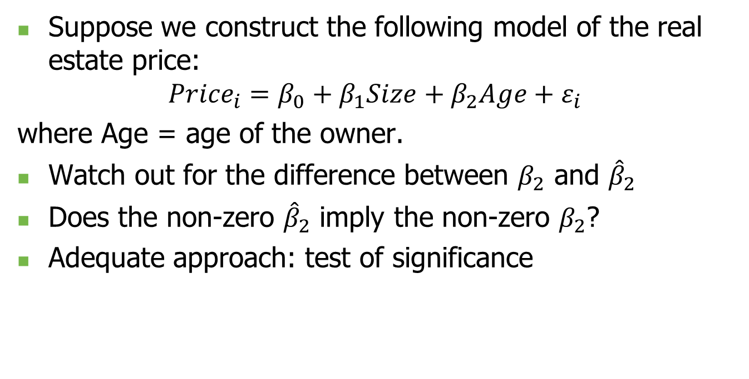
Significance of regressors
Suppose we construct the following model of the real estate price:
$${Price}_{i}=β_{0}+β_{1}Size+β_{2}Age+ε_{i}$$
where Age = age of the owner.
Watch out for the difference between $β_{2}$ and ${\hat{β}}_{2}$
Does the non-zero ${\hat{β}}_{2}$ imply the non-zero $β_{2}$?
Adequate approach: test of significance

Slide 16
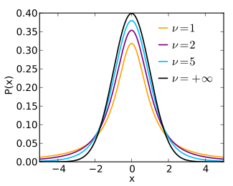
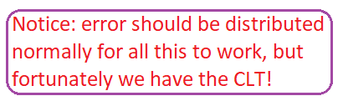
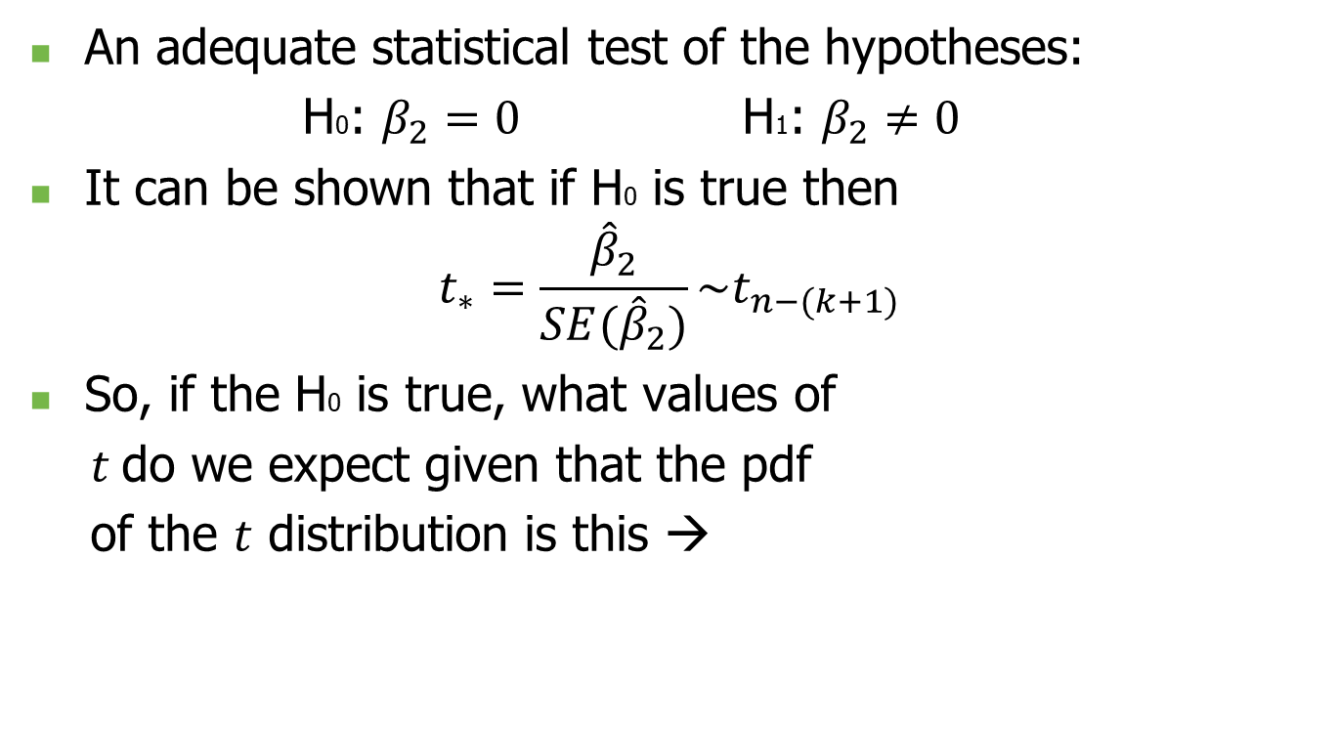
Significance of regressors
An adequate statistical test of the hypotheses:
H0: $β_{2}=0$ H1: $β_{2}≠0$
It can be shown that if H0 is true then
$$t_{∗}=\frac{{\hat{β}}_{2}}{SE({\hat{β}}_{2})}\sim t_{n−(k+1)}$$
So, if the H0 is true, what values of
$t$do we expect given that the pdf
of the $t$ distribution is this →

Slide 17
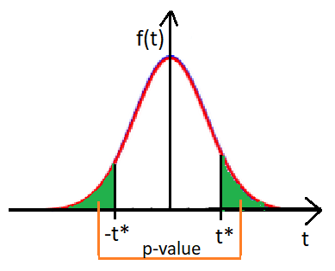
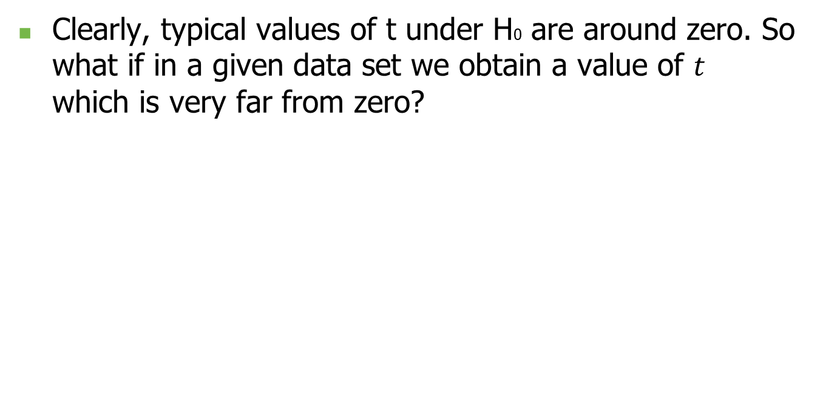
Significance of regressors
Clearly, typical values of t under H0 are around zero. So what if in a given data set we obtain a value of $t$ which is very far from zero?

Slide 18
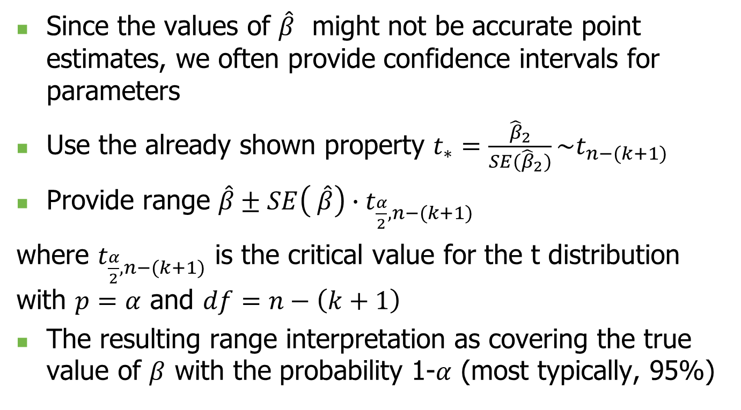
Confidence intervals
Since the values of ${\hat{β}}_{}$might not be accurate point estimates, we often provide confidence intervals for parameters
Use the already shown property $t_{∗}=\frac{{\hat{β}}_{2}}{SE({\hat{β}}_{2})}\sim t_{n−(k+1)}$
Provide range $\hat{β}±SE\left( \hat{β}\right)∙t_{\frac{α}{2},n−(k+1)}$
where $t_{\frac{α}{2},n−(k+1)}$ is the critical value for the t distribution with $p=α$ and $df=n−\left(k+1\right)$
The resulting range interpretation as covering the true value of $β$ with the probability 1-$α$ (most typically, 95%)

Slide 19
So, is that all about it?
Regression form: not always linear
Different data types: adequate models
Assumptions: validation
Alternative assumptions and different estimation techniques
Threats with inference: causality vs co-dependence
Spuriousness of regression
…

